Slide 1
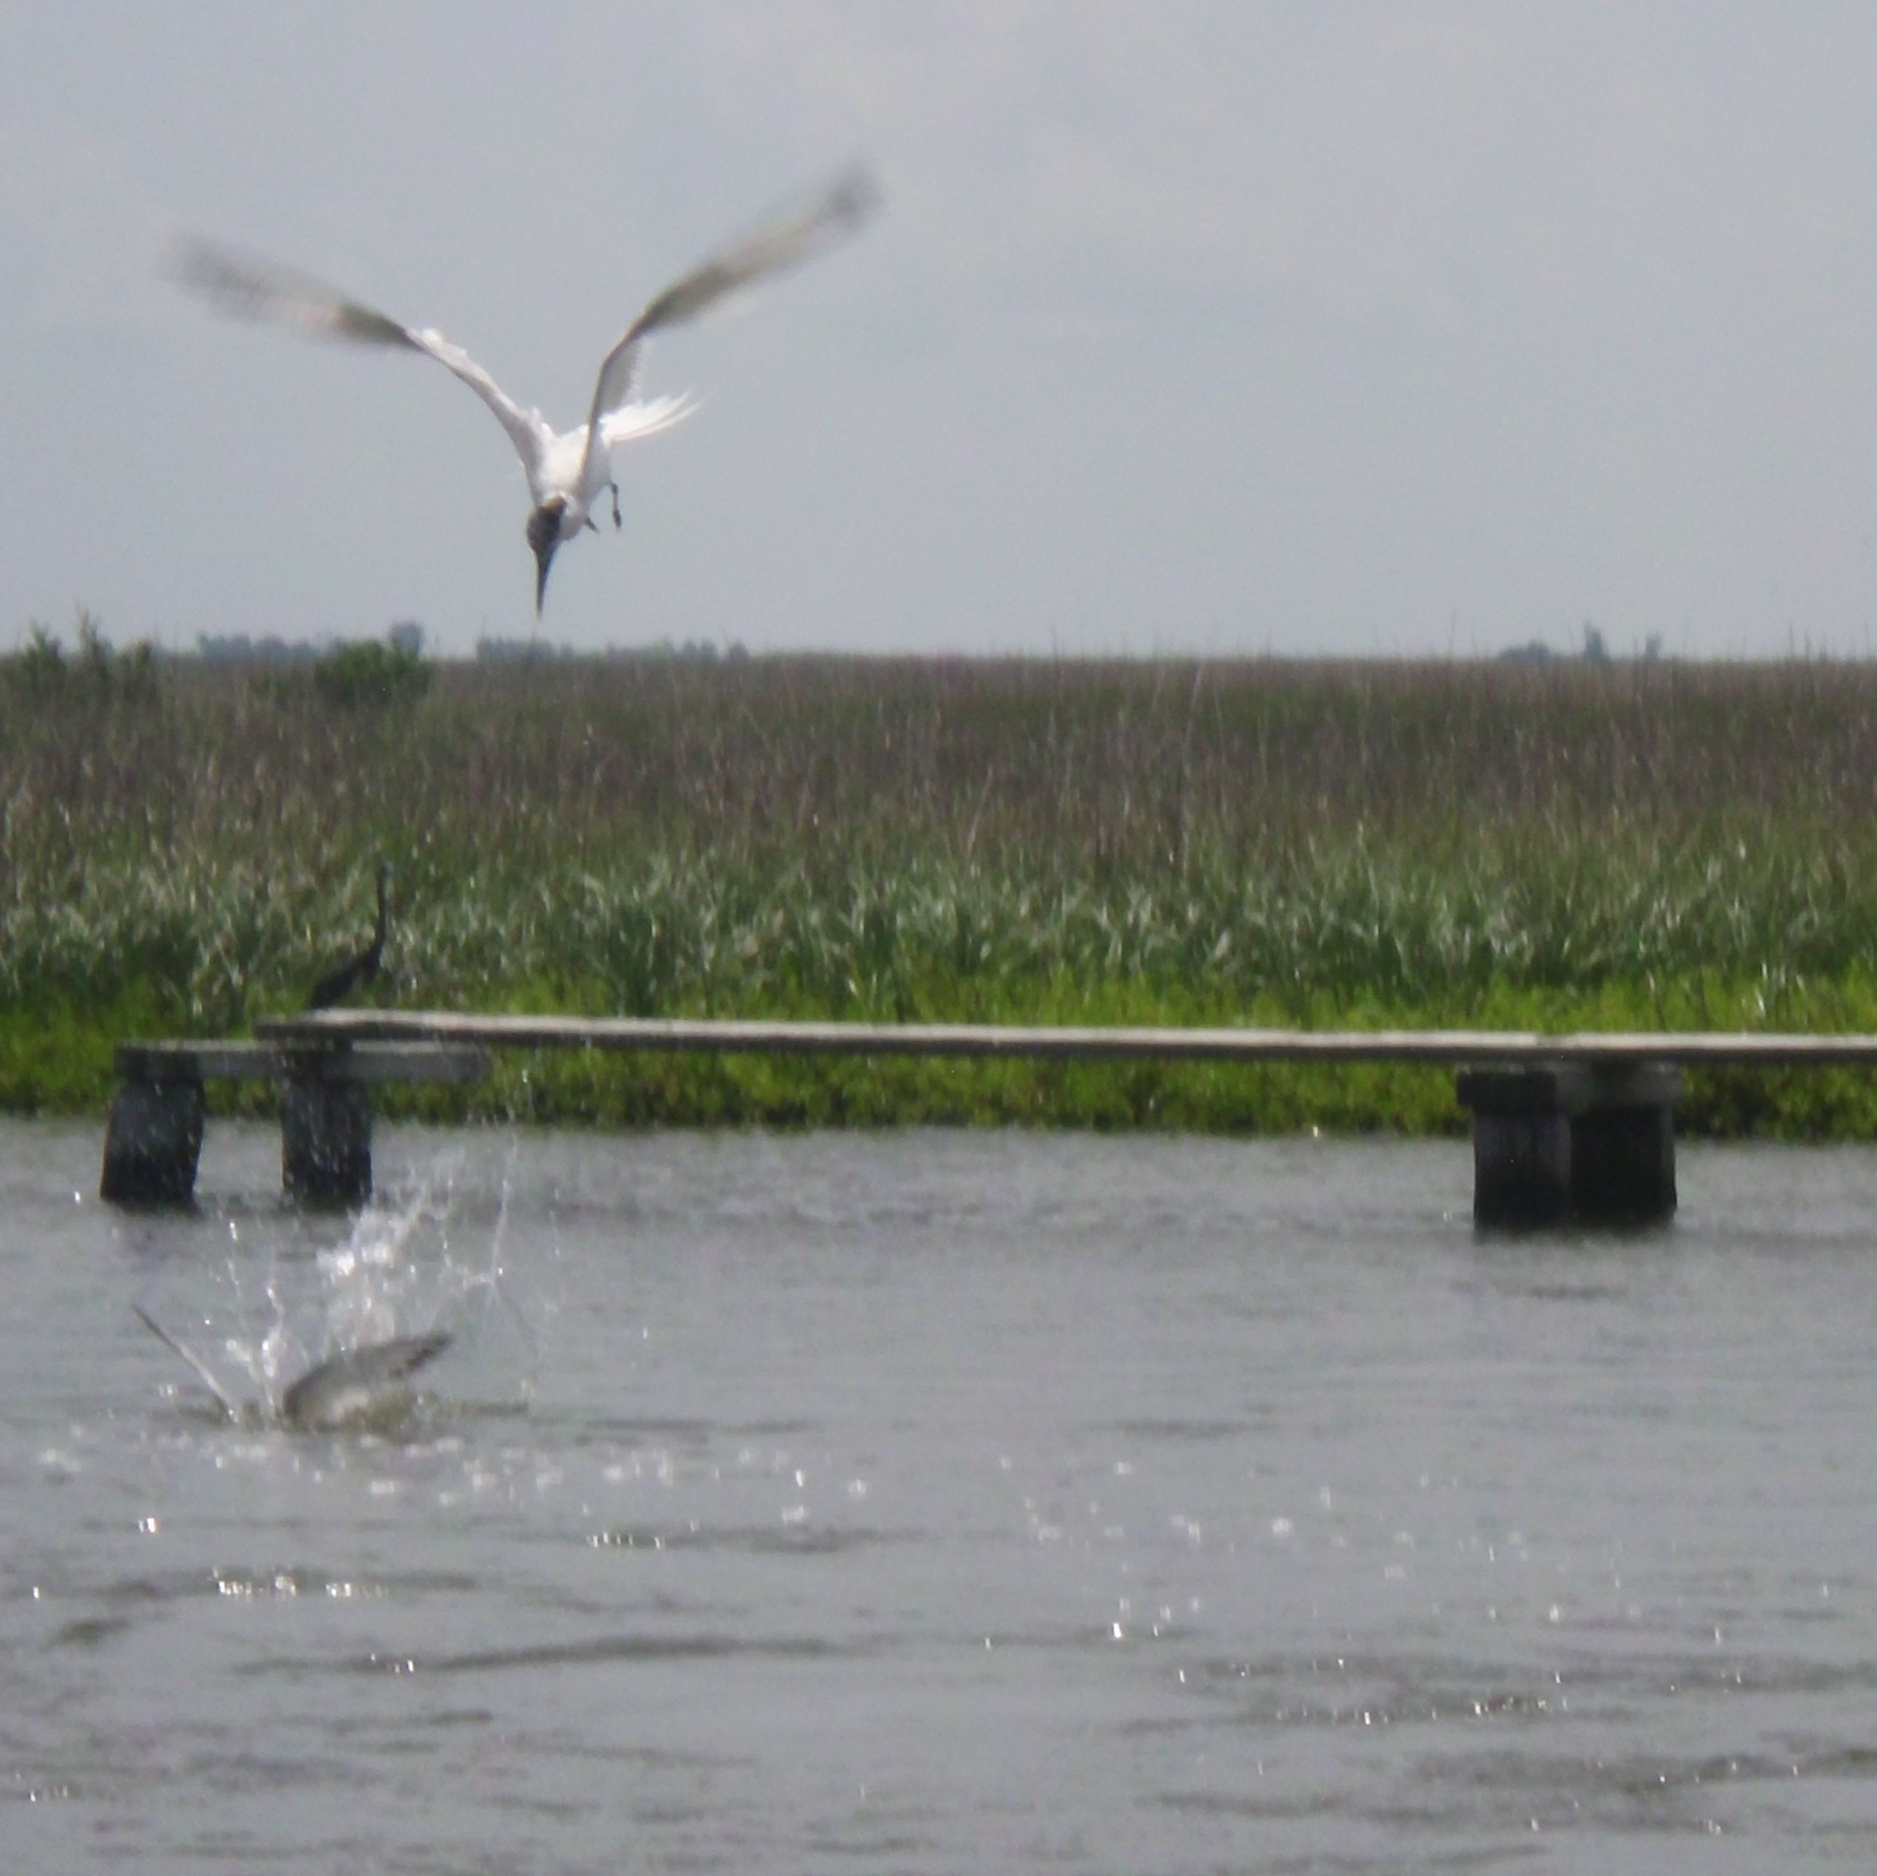
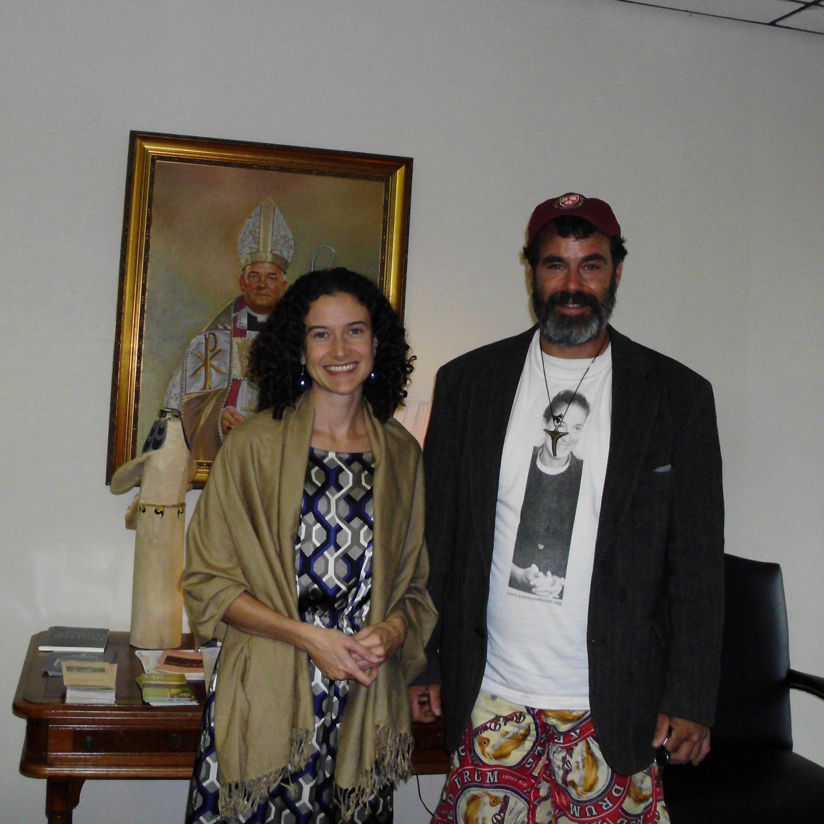
A Katrina’s Dream Project
Healing Creation:
On the Ground in
Terrebonne Parish, LA
William Gaines Swanson
T1990: God and Creation
Professor Pui Lan Kwok
Episcopal Divinity School
Notes:
Introductions
Thank you for coming.
Presentation name Healing Creation on the Ground in Terrabonne, LA
Presenting Organization

Slide 2
Katrina’s Dream
An organization dedicated to the full inclusion of women in society and other justice issues. Promoting projects such as:
  C.A.W.T.E. – a newly approved and recognized network of women theologians of the Anglican Communion.
  International Forgiveness Day – working with Worldwide Forgiveness Alliance to promote peace and understanding.
  Let’s Pass the E.R.A. – promotes and educates the passage of the Equal Rights Amendment.
  Think Tank Thuto – building primary secondary schools for the future leaders and builders of Africa.
  Torture No Prisoner’s / N.R.C.A.T. – engages in public policy advocacy and electoral campaign work to end US-sponsored torture.
Notes:
Before we go any further…
Then…
Describe Katrina’s Dream
Briefly go over the organization
CAWTE Connecting Women In Anglican
ERA – Helene briefing team, rallies
Think Tank Thuto – Bishop Trevor dinner at Lambeth HBO Series No# 1 Detective’s Agency
Torture No Prisoner’s over to Pops

Slide 3
Background
Founding member of Katrina’s Dream, an organization founded in the memory of my mother, the Rev. Katrina Martha Van Alstyne Welles Swanson one of “The Philadelphia Eleven.
Current student at Episcopal Divinity School in Cambridge, Massachusetts.
Took a Vocation Vacation and to the bayous of Louisiana to research paper for Professor Kwok’s coursework.
Witnessed the devastating long-term effects of hurricanes like Katrina and Ike that continue to ravage the Gulf of Mexico in the wake of the 2010 Oil Spill.
  Housing: rooms exposed to the elements, mold in the interiors, creating health problems for the families
  Livelihoods: fishing grounds devastated, oil company jobs halted or dwindling, auxiliary businesses
Notes:
Talk about the Katrina, the Philadelphia Eleven.
Lightly discuss EDS
Then talk about going to Louisiana to research paper.
Maybe show pictures

Slide 4
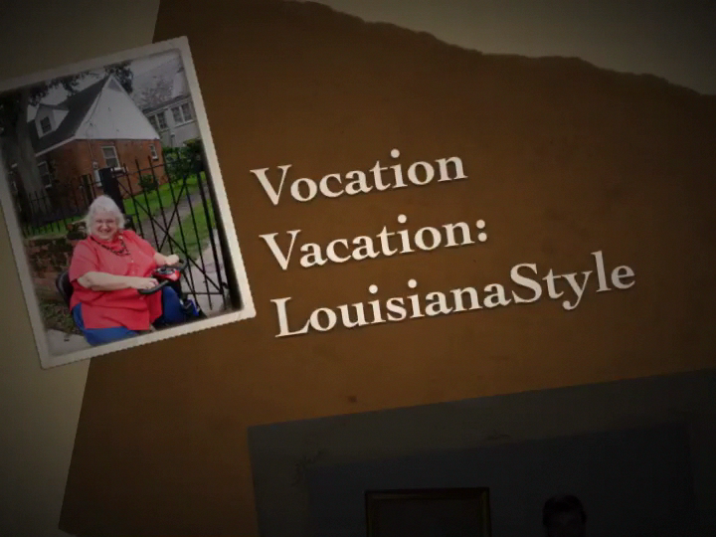
Journey to the
Louisiana Bayous

Slide 5
How the Episcopal Church is Helping
Met with the Nell Bolton, Executive Director, Diocese of Louisiana, Office of Disaster Relief.
Local assistance in Terrebonne Parish channeled by the church through Bayou Grace Community Services.
  Emergency shelter is in the local school gym.
  Working with town council for testing of water and air.
  Organizing volunteers involved with oil spill clean-up in Hazmat Training.
However, the need far exceeds the resources
Notes:
Talk about meeting Nell Bolton and the folks at Grace Bayou.

Slide 6
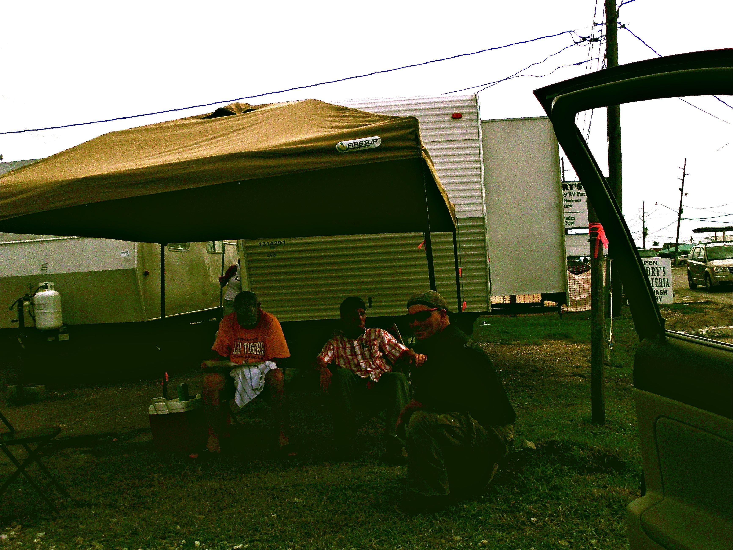
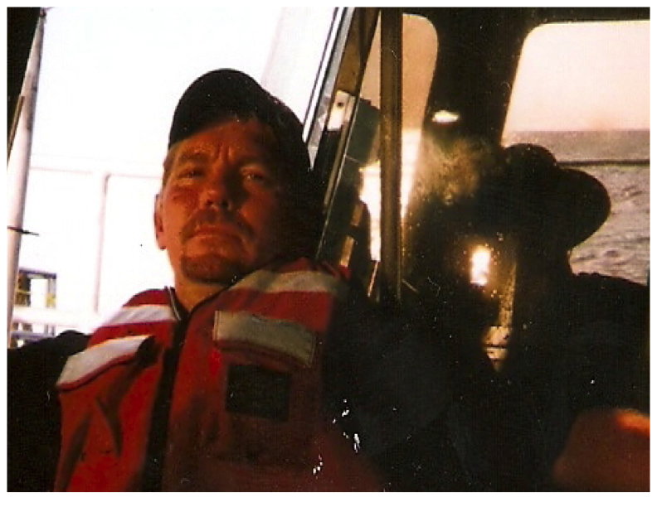
Meet the DeHart Family …
…a family in need
However, due to the disasters, little work is available except temporary hazmat clean up from the oil spill
Struggling to survive, support his family
Father of a family of four, whose teenager daughter requires special medical assistance
Comes from a generational shrimp fishing family. Worked on off-shore rigs.
Notes:
Tell the story of the phone call on the way over to Bolinas.

Slide 7

Take a tour of the De Hart Family home
Notes:
Talk about the family.

Slide 8
How can
We at Christ Church Sausalitohelp?
We can improve the lives of Todd De Hart and his family, and others like him.
We can help with:
  Gifts for Christmas.
  Assistance in obtaining his Captain’s License.
  Materials to rebuild his home.
If we step forward as a church family to help Todd’s family, others may be encouraged to follow our lead.
Notes:
Make the “ask” for help.
Talk about donation of materials from an business like Home Depot
Shipping things directly to the Dehart’s home through on-line catalogs.
Congegants talking to other organizations soliciting help.

Slide 9
A Happier Christmas!
Our idea: help the De Hart Family this Christmas by chipping in to buy them items on their wish list
  Compile the list
  People can sign up for various gifts
  Gifts can be purchased online and shipped directly to the family in time for Christmas
Discussion / Questions?
Contact
william@katrinasdream.org
Notes:
Field Questions.

